Slide 1


OBIstat:
Ontological Representation of Biostatistics Terms
Yongqun “Oliver” He, Marcy Harris
University of Michigan
Ann Arbor, MI 48109, USA

Slide 2
Ontological Representation of Statistical Analyses
OntoDM:
Ontological representation of data mining tasks and complex data types.
http://kt.ijs.si/panovp/doku.php?id=ontodm
HELO: Hypothesis and Law Ontology
https://github.com/larisa-soldatova/HELO
Both with specific focuses and align with IAO
Other related ontologies?

Slide 3
OBIstat: An OBI Subset and Extension with a focus on statistics
OBI is large and has many focuses
Goal: Develop an OBI subset with a specific focus on statistics
Strategy: two methods:
Obtaining existing statistics terms in OBI: using OntoFox MIREOT method
Generating new statistics terms (which are expected to be vetted and become part of OBI later
Note: OBIstat includes both parts

Slide 4
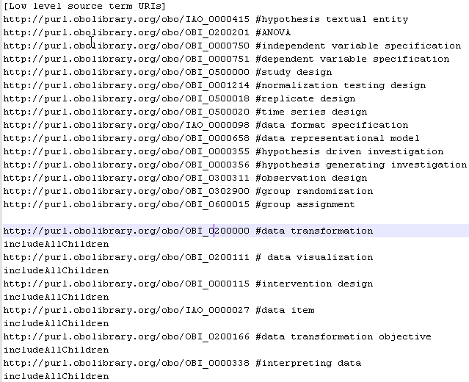
Fetching OBI statistics subset using OntoFox
OntoFox input: defining OBI terms to fetch:
Many OBI branches are fully taken

Slide 5
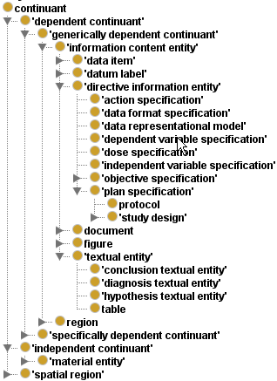
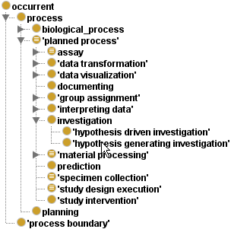

Results: The OBI subset focusing on Biostatistics
Get all branch terms:
data transformation
data visualization
intervention design
data item
data transformation objective
intepreting data
Maintain inferring capability

Slide 6
Generating New Statistics Terms
Defined an Excel worksheet template for representing new statistics terms
Specified 118 new statistics terms using the template
URL: http://obi.svn.sourceforge.net/viewvc/obi/trunk/docs/presentations/OBI%20workshop%20May%202012%20Ann%20Arbor/OBI%20Statistics/OBIstat%20source/OBIStat_new_terms_IDs-v2.xlsx?revision=3745
Ontorat tool (http://ontorat.hegroup.org) was used to convert the Excel results to OWL file
Refined the results in Protégé-OWL editor

Slide 7
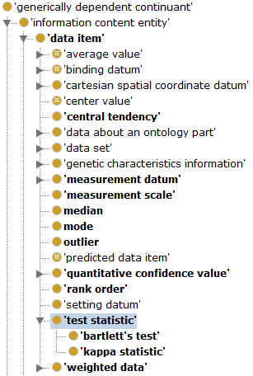
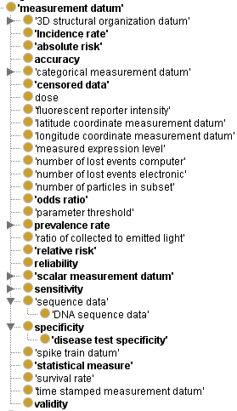
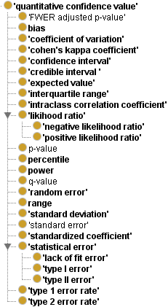
Added many terms under OBI “data item”
Can add more test statistics later

Slide 8
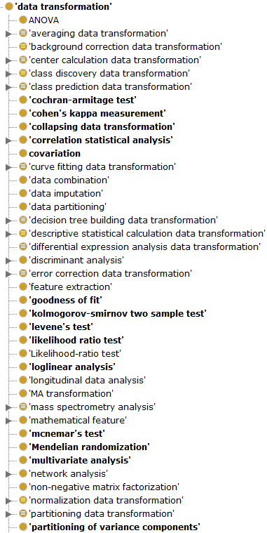
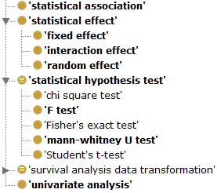
Added many terms under OBI ‘data transformation’
Jessica: which should be under ‘statistical hypothesis test’?
Note: It is a defined class:
every subclass inherits the axiom

Slide 9
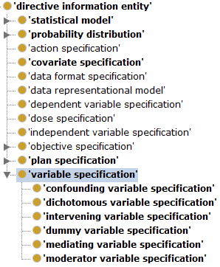
New term ‘variable specification’ and many of its subclasses
Def: “a directive information entity that specifies a statistical variable whose value may change within the scope of a given problem or set of operations”
May move all variables to under this term, including:
Independent variable specification
Dependent variable specification
Notes:
Look for other ontologies for such term definitions.

Slide 10
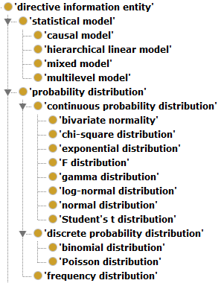
‘statistical model’ and ‘probability distribution’
Initially the term ‘probability distribution’ was classified under ‘data item’, and the term ‘statistical model’ was under ‘data transformation’.
After discussion in the OBI call in April 8th, 2013, I have transferred them under ‘directive information entity’, which appears to have the maximum consensus.
Notes:
Look for other ontologies for such term definitions.

Slide 11
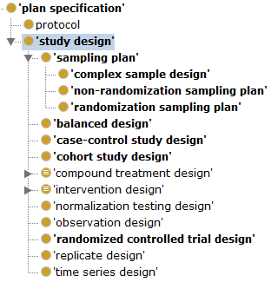
Make the ‘sampling plan’ a subclass of ‘study design’
Study design Def:
“A study design is a plan specification comprised of protocols (which may specify how and what kinds of data will be gathered) that are executed as part of an investigation and is realized during a study design execution.”
Sampling plan def:
“a plan specification that provides a detailed outline of which measurements will be taken at what times, on which material, in what manner, and by whom.”
Notes:
Look for other ontologies for such term definitions.

Slide 12
OBI Biostatistics Subset Design Pattern
Study design
part_of?
hypothesis textual entity
is_about
data item
(e.g., p-value)
has_specified_output
has_
specified
_input
hypothesis driven investigation
data item
(input data set)
data transformation
achieves_
planned_objective
has_specified_input
data visualization
data transformation objective
What about a specific statistics test?
Notes:
realizes some (concretizes some ‘study design')

Slide 13
What a specific statistical method does?
A specific statistical test like t-test has the following components:
The test label, e.g., student’s t-test
Test statistic
Mathematic model
Test distribution, e.g., , student’s t distribution
Test result value, e.g., p-value
Hypothesis
We want to represent each of these

Slide 14
Challenges
How to represent mathematic formula using ontology?
How to represent statistical null hypothesis?
How to run ontology-supported statistical analysis within the context of semantic web?

Slide 15
Acknowledgements
OBI Consortium, IAO
Philippe Rocca-Serra, Alfred Hero,
Jessica Turner, and others in the 2012
OBI face-2-face Ann Arbor workshop
Bjoern Peters, Chris Stoeckert, Jie Zheng,
Philippe Rocca-Serra, James A. Overton, and
all in the April 8th 2013 OBI conference call
NIH-NIAID Grant: R01AI081062

